Slide 1
MBA532 – AI in Business
MODULE 5 – AI’s impact on Work, Jobs, Humans, Productivity

Slide 2
Impact of AI on Job Losses
Impact of AI on Job Losses

Slide 3
Source: Goldman Sachs Predicts 300 Million Jobs Will Be Lost Or Degraded By Artificial Intelligence
Goldman contends automation creates innovation, which leads to new types of jobs. For companies, there will be cost savings thanks to AI. They can deploy their resources toward building and growing businesses, ultimately increasing annual global GDP by 7%.
Between 2021 and 2023, investments in AI totaled nearly $94 billion, according to Stanford’s AI Index Report. If AI continues this growth trajectory, it could add 1% to the U.S. GDP by 2030.
According to a 2021 NBER research paper titled “Tasks, Automation, and the Rise in US Wage Inequality” automation technology has been the prime driver of income inequality for the past four decades. Automation arising from Artificial intelligence, robotics and new sophisticated technologies have already caused a vast chasm in wealth and income inequality, and it looks like this issue will accelerate.

Slide 4
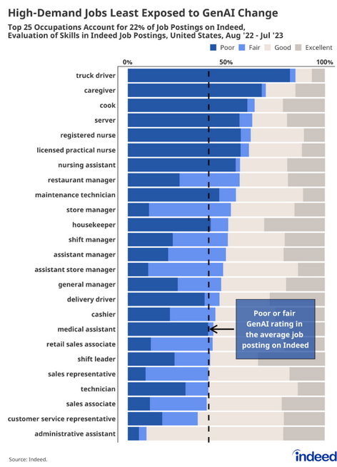
Source:
Indeed.com

Slide 5
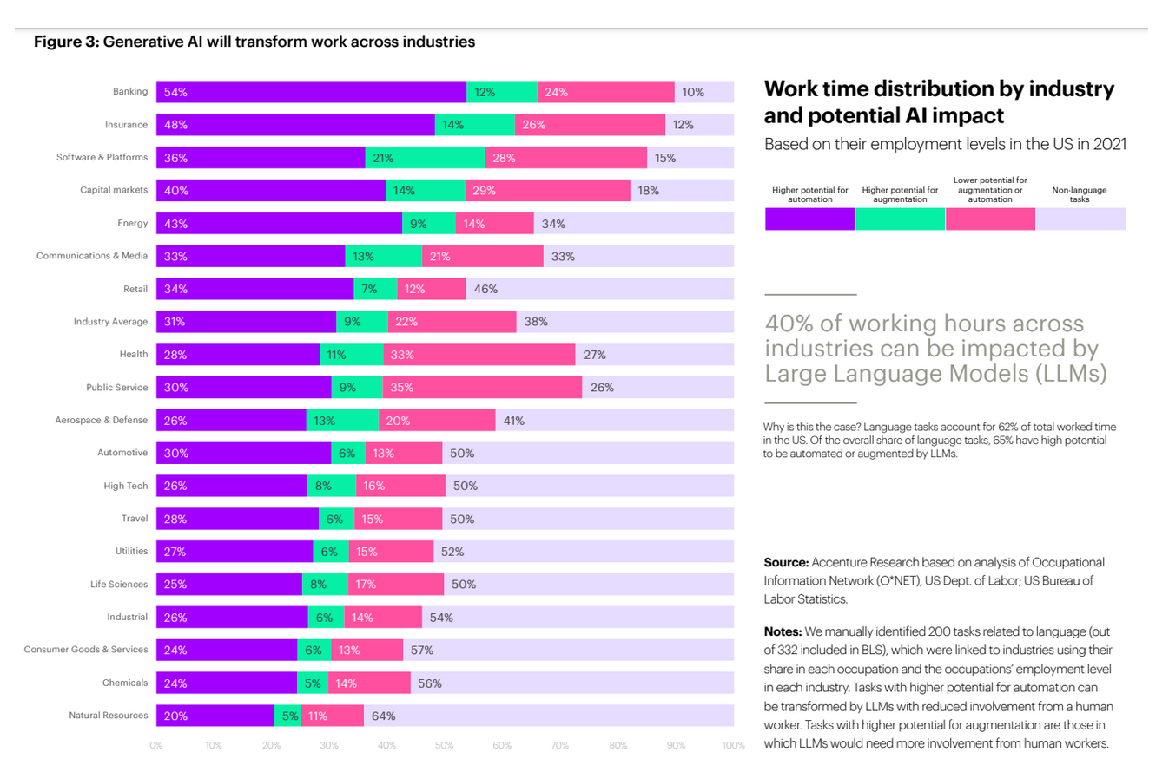
Generative Impact across Industries (source: World Economic Forum, May 2023

Slide 6
WEF 2023: Gen AI Across Industries impact….
Banking and Insurance have the highest potential for automation of jobs (54% and 48% respectively); Chemicals and Natural Resources have relatively lower potential for automation (24% and 20% respectively.
It is clear that jobs in all industries will be adversely affected by Generative AI impact.
Unfortunately, the earlier reports on the positive impact of Generative AI on productivity and growth metrics have to be interpreted in conjunction with these expected job losses.

Slide 7
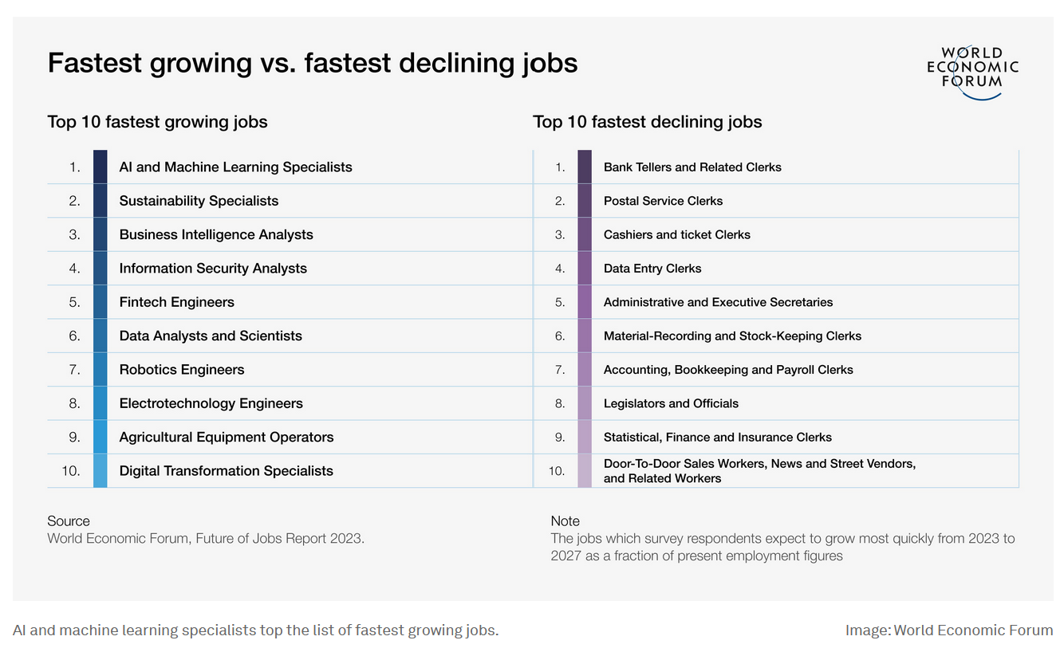
WEF 2023: Gen AI Across Industries impact….

Slide 8
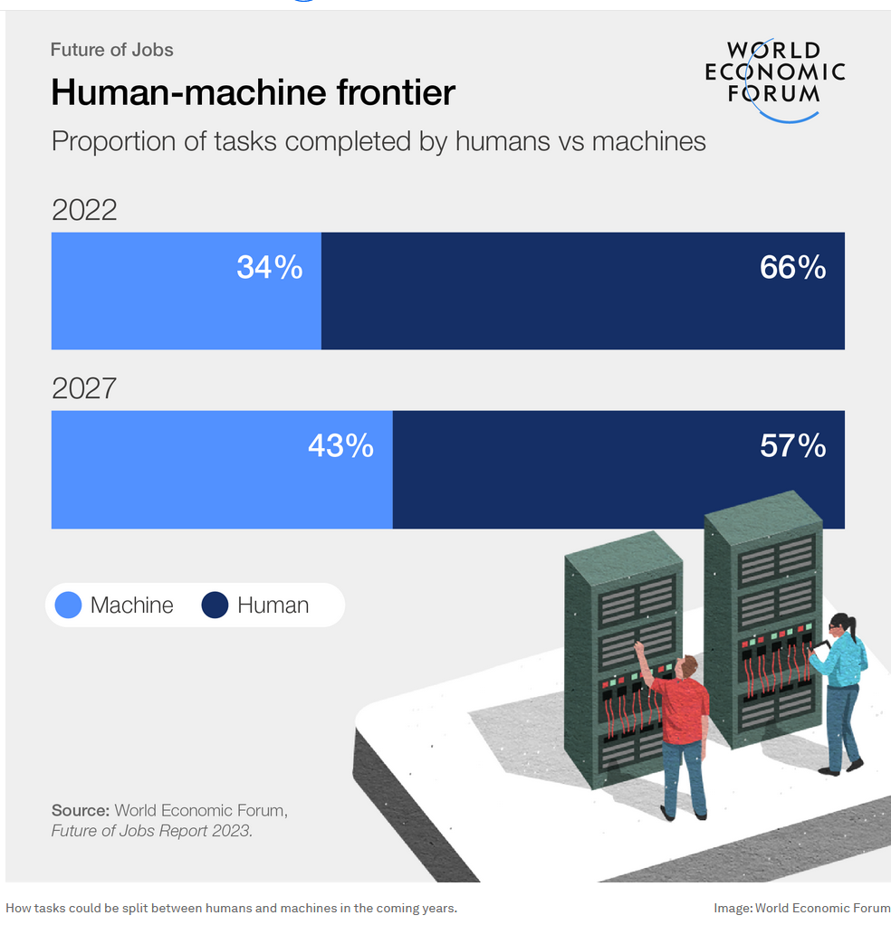
WEF 2023: Proportion of tasks completed by humans is decreasing….

